Slide 1
Fooder
Simon Fu, Jack Wu, Wendy chen, Matheus schaly

Slide 2
Requirements
Functional Requirements (defines what the system should do)
The system shall allow the user to upload images stored in their mobile device
Non-functional Requirements (defines how the system will do it)
The system shall have a maximum file upload size of 100MB
Assumptions made examples
All project team members are available during the project time frame
Funding is available when the project starts
Notes:
We defined several functional and non-functional requirements for our application, which are all documented in our SRS.
We also include any assumptions that have been made by the requirements engineering team when gathering and analyzing the requirements. If any of the assumptions are found to be false, the SRS would need to be re-evaluated to make sure its contents are still valid

Slide 3
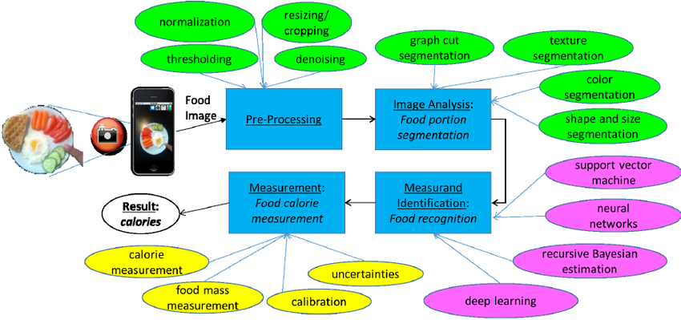
Backend Design

Slide 4
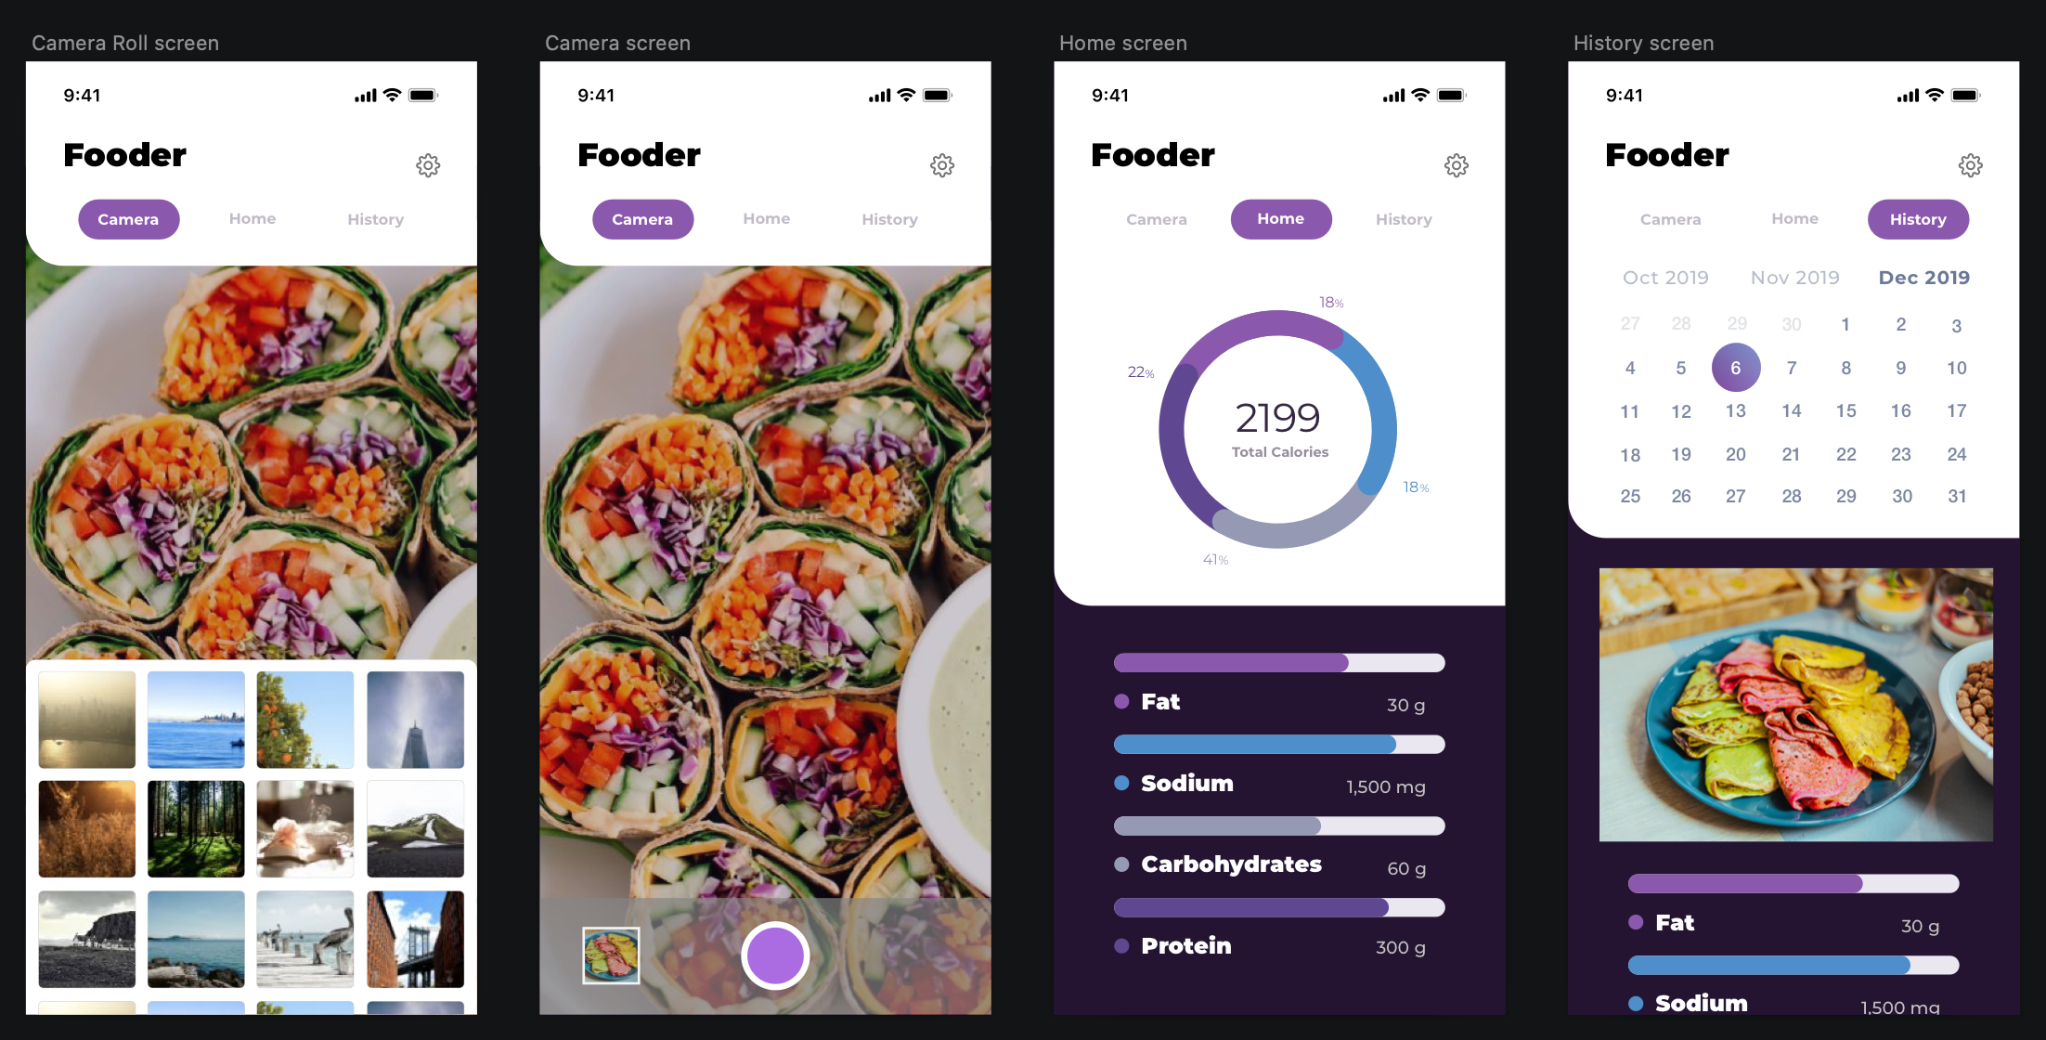
Frontend UI Design
Notes:
- Clean
- Swiping

Slide 5
Development Methodology
Iterative and Incremental (I&I):
Advantages over Waterfall:
Continuous customer feedback.
Iterative development cycles.
Works better for innovative work.
Advantage over Agile:
Initial commitment.

Slide 6
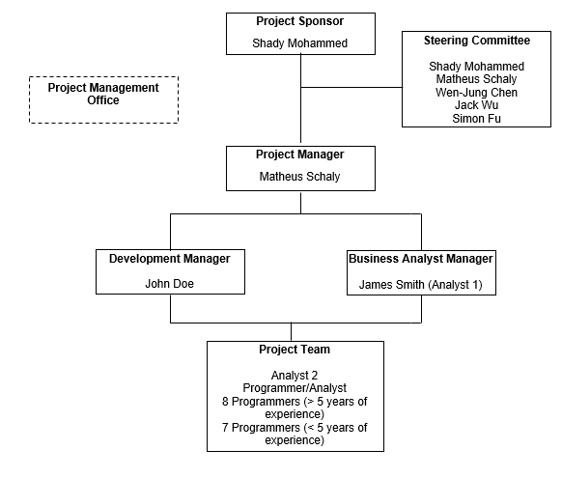
Organization

Slide 7
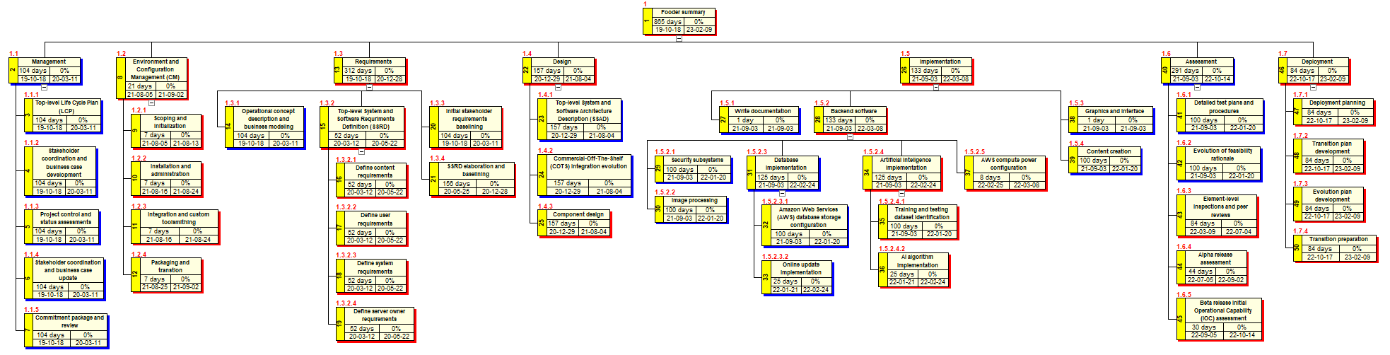
Work breakdown structure

Slide 8
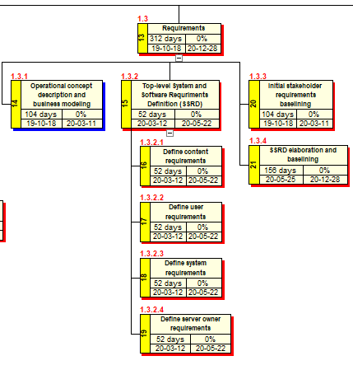
Work breakdown structure

Slide 9
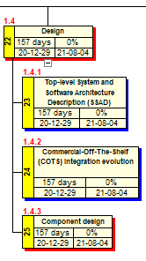
Work breakdown structure

Slide 10
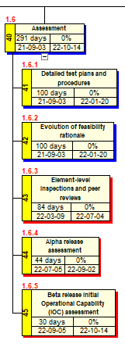
Work breakdown structure

Slide 11
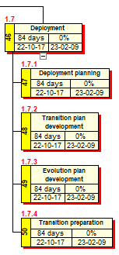
Work breakdown structure

Slide 12
Schedule
Size: functions points method
Adjusted functions points: 187.58.
KLOC: 9.941 (Java).
Staff-months and months: COCOMO intermediate embedded method
Employees: 23.
Duration: 24 months.
01-dec-2019 to 01-dec-2021.

Slide 13
Budget
Software Developers:
2 Entry-level: C$ 22,00/hour
5 Early-career: C$ 22,49/hour
5 Mid-career: C$ 35,57/hour
1 Experienced: C$ 65,00/hour
2 Late-career: C$ 59,00/hour
Resource Type Expenditure | Total Project Costs
Labour | C$ 3,139,552.36
Programmer Analyst:
2 Late-career: C$ 50.05/hour
Software Engineers:
1 Mid-career: 29.53/hour
1 Late-career: 61.92/hour
Project Managers:
4 Entry-level: 20.59/hour
Antecipated hours of work: mostly 3,992 and some 3,832.

Slide 14
Budget
Resource Type Expenditure | Total Project Costs
Labour | C$ 3,139,552.36
Hardware | C$ 14,250.00
Software | C$ 2,548.85
Contracted Services | C$ 2,824.60
Contingency | C$ 399,787.25
Cost to Complete | C$ 3,498,963.06

Slide 15
Configuration Plan
Versioning
Backtracking

Slide 16
Change control Plan
Generate change request (CR)
Log CR status
Evaluate CR
Authorize
Implement
Notes:
CR content:
- Date
- CR #
- Title
- Description
- Submitter
- Phone
- E-mail
- Product
- Version
- Priority

Slide 17
Test Plan
Test Case ID | Scenario | Steps | Data | Expected Results
FT-001 | Check Customer Login with Valid Data | 1. Open Fooder 2. Enter ID 3. Enter Password 4. Click Submit | Userid = fooder100 Password = pass100 | User is logged in to the application
IT-008 | Image Processing | Open Fooder, Swipe to Camera tab, Click bottom center, Image is processed, return values | N/A | Front end receive calculated data using our image processor, calculation algorithm and is presented to the user
AT-010 | G: Past Photos W: Select History T: Interact with Calendar to view history | Open Fooder, History Tab, Select Date, View photos on selected date | Some demo history on the device | User should be able to interact with a calendar to view their photo history
Notes:
The testing methods we used in this application is Unit, Functional, Acceptance and System Integration.
In the table are three test cases for Functional, Integration, and Acceptance testing.

Slide 18
Top 5 Risks
Unexpected downtime from service providers
Unforeseen complexity of our backend system
Unforeseen changes
Turnover of employees
Overbudget & overtime
Notes:
Talk about how to mitigate those risks.

Slide 19
Lessons Learned - What can be used for future projects?
Understanding the Requirements
With the lack of communication and stakeholder involvement, are all needs captured?
Asking the right questions to make sure requirements are correct
Be proactive in communicating with the customer on this topic
Avoids bad acceptance tests
Scheduling
We should follow some standard method for scheduling deadlines for better accuracy
Current predictions may be more fragile to change, unforeseen circumstances, etc.
Notes:
There will be ambiguity of exactly what the customer wants if the team doesn't communicate with the customer well
Its good to be more proactive in working with the customer
Overall allows for a smoother dev process, not as much going back for changes
Can make improvements on selecting deadlines for certain project milestones. Not using a good standard method can be fragile to change and unforeseen circumstances

